Slide 1


ITEM MASTER(STOCK AND NON STOCK)
Amarnath

Slide 2
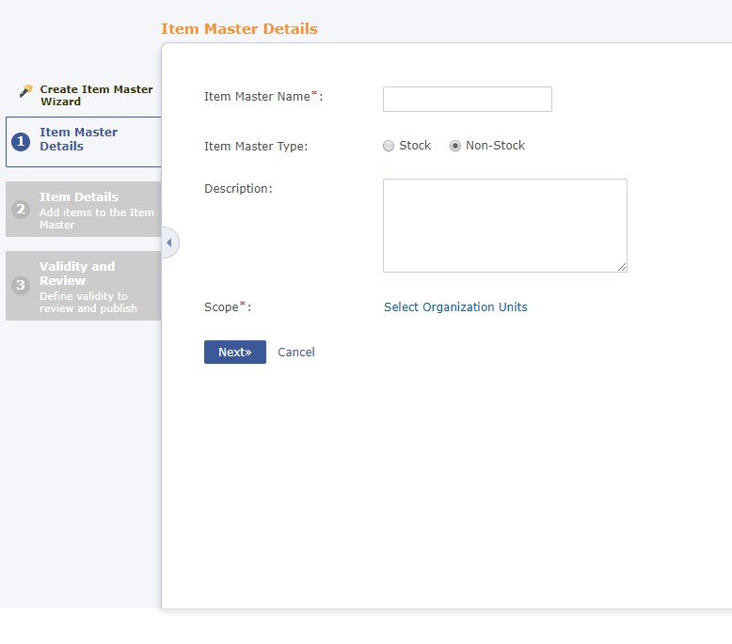
ITEM MASTER
An entity/catalog that contain single or multiple items.
Types: Stock and Non Stock.
Items can be directly viewed on the online store if they fall under the requesting scope of the user.

Slide 3
TYPES OF ITEM MASTERS
Option of warehouse(Not mandatory).
Option of Supplier(Not mandatory).
STOCK

Slide 4
TYPES OF ITEM MASTER
No option of warehouse.
Option of Supplier(Not mandatory).
NON STOCK

Slide 5

WHAT HAPPENS IN THE BACK??

Slide 6
STOCK ITEM MASTER ITEM
1 row gets inserted in the ITEM_MASTER_ITEM Table.
1 row gets inserted in the ITEM_MASTER_ITEM_WAREHOUSE Table if Item Master has Warehouse.
ITEM_MASTER_ITEM_WAREHOUSE has AUTO_ID of ITEM_MASTER ITEM Table.

Slide 7
NON STOCK ITEM MASTER ITEM
1 row gets inserted in the ITEM_MASTER_ITEM Table.
1 row gets inserted in the ITEM_MASTER_ITEM_SUPPLIER Table if item has supplier.
ITEM_MASTER_ITEM_SUPPLIER has AUTO_ID of ITEM_MASTER ITEM Table.

Slide 8
THANK YOU

